Slide 1
SRM Institute of Science and Technology Advanced Programming Practice-18CSC207J Functional Programming Paradigm

Slide 2
Functional Programming Paradigm
Unit-III (15 Session)
Session 11-15 cover the following topics:-
Definition - S11-SLO1
Sequence of Commands – S11-SLO2
map(), reduce(), filter(), lambda – S12-SLO1
partial, functools – S12-SLO2
Other languages:F#, Clojure, Haskell – S13-SLO1
Demo: Functional Programming in Python - S13-SLO2
Lab 9: Functional Programming ( Case Study) (S14-15)
Assignment : Comparative study of Functional programming in F#, Clojure, Haskell
TextBook: Shalom, Elad. A Review of Programming Paradigms Throughout the History: With a Suggestion Toward a Future Approach, Kindle Edition

Slide 3
Functional Programming Paradigm ( TF1)
Definition
Mainly treat computation to evaluate mathematical Functions
Avoids changing-state and mutable data
Called as declarative programming paradigm
Output depends on argument passing
Calling same function several times with same values produces same result
Uses expressions or declarations rather than statements as in imperative languages

Slide 4
Concepts
It views all subprograms as functions in the mathematical sense
Take in arguments and return a single solution.
Solution returned is based entirely on input, and the time at which a function is called has no relevance.
The computational model is therefore one of function application and reduction.

Slide 5
Characteristics of Functional Programming
Functional programming method focuses on results, not the process
Emphasis is on what is to be computed
Data is immutable
Functional programming Decompose the problem into 'functions
It is built on the concept of mathematical functions which uses conditional expressions and recursion to do perform the calculation
It does not support iteration like loop statements and conditional statements like If-Else

Slide 6
Real Time applications
Database processing
Financial modeling
Statistical analysis and
Bio-informatics

Slide 7
Functional Programming Languages
Haskell
SML
Clojure
Scala
Erlang
Clean
F#
ML/OCaml Lisp / Scheme
XSLT
SQL
Mathematica

Slide 8
Functional Vs Procedural
S.No | Functional Paradigms | Procedural Paradigm
1 | Treats computation as the evaluation of mathematical functions avoiding state and mutable data | Derived from structured programming, based on the concept of modular programming or the procedure call
2 | Main traits are Lambda calculus, formula, recursion, referential transparency | Main traits are Local variables, sequence, selection, iteration, and modularization
3 | Functional programming focuses on expressions | Procedural programming focuses on statements
4 | Often recursive. Always returns the same output for a given input. | The output of a routine does not always have a direct correlation with the input.
5 | Order of evaluation is usually undefined. | Everything is done in a specific order.
6 | Must be stateless. i.e. No operation can have side effects. | Execution of a routine may have side effects.
7 | Good fit for parallel execution, Tends to emphasize a divide and conquer approach. | Tends to emphasize implementing solutions in a linear fashion.

Slide 9
Functional Vs Object-oriented Programming
S.No | Functional Paradigms | Object Oriented Paradigm
1 | FP uses Immutable data. | OOP uses Mutable data.
2 | Follows Declarative Programming based Model. | Follows Imperative Programming Model.
3 | What it focuses is on: "What you are doing. in the programme." | What it focuses is on "How you are doing your programming."
4 | Supports Parallel Programming. | No supports for Parallel Programming.
5 | Its functions have no-side effects. | Method can produce many side effects.
6 | Flow Control is performed using function calls & function calls with recursion. | Flow control process is conducted using loops and conditional statements.
7 | Execution order of statements is not very important. | Execution order of statements is important.

Slide 10
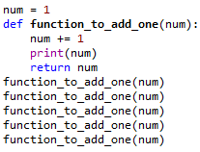
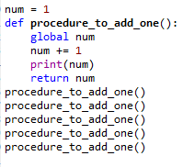
Example
Functional Programming
Procedural Programming

Slide 11
Features of Functional paradigms
First-class functions – accept another function as an argument or return a function
Pure functions - they are functions without side effects
Recursion - allows writing smaller algorithms and operating by looking only at the inputs to a function
Immutable variables - variables that cannot be changed
Non-strict evaluation or Lazy evaluation- allows having variables that have not yet been computed
Statements - evaluable pieces of code that have a return value
Pattern matching - allows better type-checking and extracting elements from an object

Slide 12
Functions as first class objects in python
A function is an instance of the Object type.
Stores the function in a variable.
Passes the function as a parameter to another function.
Returns the function from a function.
Stores them in data structures such as hash tables, lists, …

Slide 13


Functions are objects
A function is assigned to a variable. This assignment doesn’t call the function. It takes the function object referenced by shout and creates a second name pointing to it, yell.

Slide 14
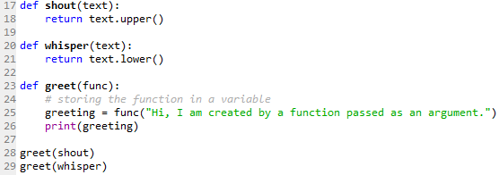
Functions can be passed as arguments to other functions
Since functions are objects we can pass them as arguments to other functions. Functions that can accept other functions as arguments are also called higher-order functions.

Slide 15
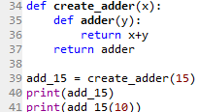
Functions can return another function
Since functions are objects we can return a function from another function.

Slide 16

Example

Slide 17
Pure Functions
A function is called pure function if it always returns the same result for same argument values and it has no side effects like modifying an argument (or global variable) or outputting something
Examples of pure functions are strlen(), pow(), sqrt() etc.
Examples of impure functions are printf(), rand(), time(), etc.

Slide 18
Anonymous functions in Python
Anonymous functions are split into two types: lambda functions and closures.
Functions are made of four parts:
Name
Parameter list
Body
Return

Slide 19
Anonymous/Lambda Function
In Python, anonymous function is a function that is defined without a name.
While normal functions are defined using the def keyword, in Python anonymous functions are defined using the lambda keyword.
lambda arguments: expression
Lambda functions can have any number of arguments but only one expression. The expression is evaluated and returned. Lambda functions can be used wherever function objects are required.

Slide 20


Example
Argument
Identifier
Expression
Using function

Slide 21
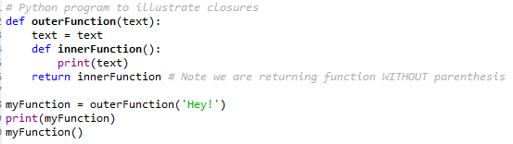
Closure in Python
A Closure is a function object that remembers values in enclosing scopes even if they are not present in memory.

Slide 22
Immutable variables
Immutable variable (object) is a variable whose state cannot be modified once it is created.
In contrast, a mutable variable can be modified after it is created
Example
>>String str = “A Simple String.”;
>>str.toLowerCase();

Slide 23
Functional programming tools
filter(function, sequence)
def f(x): return x%2 != 0 and x%3 ==0
filter(f, range(2,25))
map(function, sequence)
call function for each item
return list of return values
reduce(function, sequence)
return a single value
call binary function on the first two items
then on the result and next item
iterate

Slide 24

Map() Function
map() function returns a map object(which is an iterator) of the results after applying the given function to each item of a given iterable (list, tuple etc.)

Slide 25
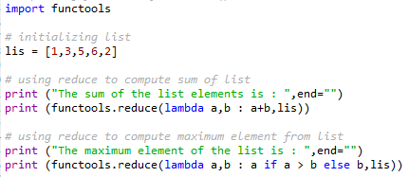

Reduce() Function
The reduce(fun,seq) function is used to apply a particular function passed in its argument to all of the list elements mentioned in the sequence passed along.
This function is defined in “functools” module.

Slide 26
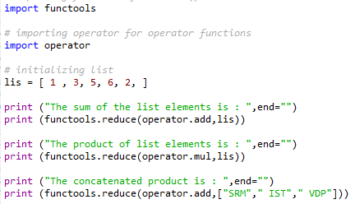


Slide 27
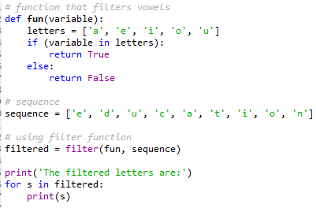

Filter() Function
The filter() method filters the given sequence with the help of a function that tests each element in the sequence to be true or not.

Slide 28
Advantages
Allows you to avoid confusing problems and errors in the code
Easier to test and execute Unit testing and debug FP Code.
Parallel processing and concurrency
Hot code deployment and fault tolerance
Offers better modularity with a shorter code
Increased productivity of the developer
Supports Nested Functions
Functional Constructs like Lazy Map & Lists, etc.
Allows effective use of Lambda Calculus

Slide 29
Disadvantages
Perhaps less efficiency
Problems involving many variables or a lot of sequential activity are sometimes easier to handle imperatively
Functional programming paradigm is not easy, so it is difficult to understand for the beginner
Hard to maintain as many objects evolve during the coding
Needs lots of mocking and extensive environmental setup
Re-use is very complicated and needs constantly refactoring
Objects may not represent the problem correctly

